Slide 1

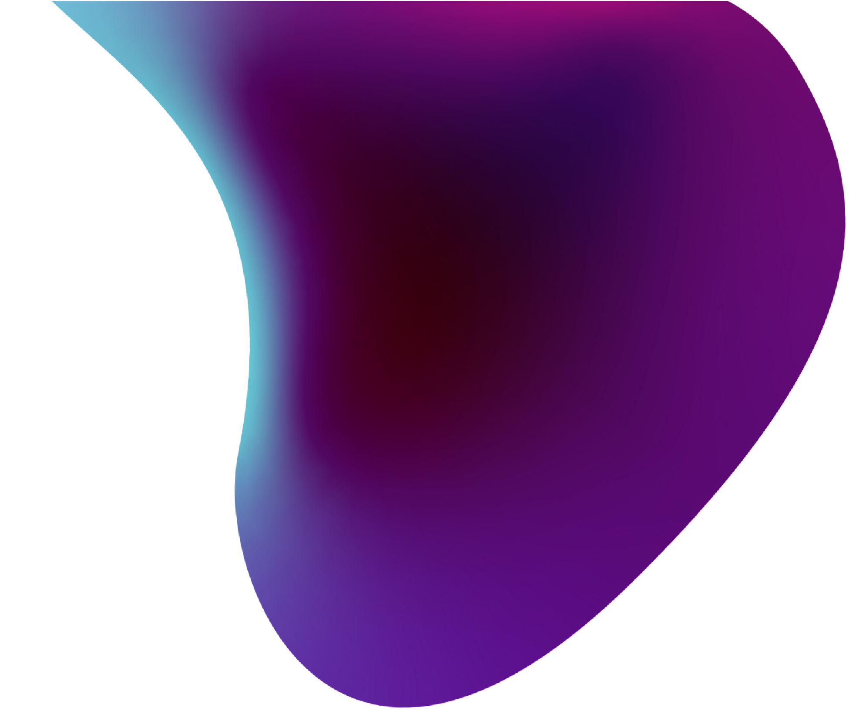


BioVisionAR
“An interactive AR-based learning tool that transforms biology education by immersing students in 3D models and dynamic visualizations.”
By:MetaAchievers

Slide 2



BioVisionAR: Revolutionizing Biology Learning
Objective: To create an interactive AR experience that enhances students' understanding of biology.
Features:
Immersive 3D Models: Visualize biological structures in AR.
Enhanced Engagement: Features like rotating, zooming, and exploring layers make learning hands-on.
Student-Centric Learning: Encourages independent exploration and discovery in biology.

Slide 3




Project Scope and Objectives
Immersive Learning
Develop a Unity-based AR app for exploring
intricate 3D models of biological structures.
Enhanced Engagement
Create interactive experiences to boost student
participation and knowledge retention.
Cross-Platform Compatibility
Ensure seamless functionality across various devices
using AR Foundation framework.

Slide 4







Technological Stack
UNITY
Utilized for core development, leveraging its powerful AR capabilities.
AR Foundation
Implemented for cross-platform AR functionality and device optimization
Blender
Employed for creating high-fidelity, low-poly 3D anatomical models.
C#
Used for scripting complex interactions and AR behaviors.
Visual Studio
Integrated development environment for coding

Slide 5



Key Insights and Justifications
AR enhances engagement by enabling students to interact with realistic 3D models.
The use of Unity’s AR Foundation ensures seamless integration across devices.
3D models such as the heart and skeleton provide hands-on learning experiences.
The application’s ease of use and interactivity support learning for diverse groups.

Slide 6



Development Pipeline
1
Conceptualization
Assessed AR’s potential for enhancing biology education, defining the app’s main features.
2
AR Environment Setup
Configured Unity with AR Foundation for reliable object tracking and interaction.
Asset Integration
Imported optimized 3D models for mobile performance.
3
UX Optimization
Developed intuitive UI with touch gestures for easy interactions with 3D models.
4
Iterative Testing
Ensured stability in tracking, model quality, and user experience.
5

Slide 7



Benefits of AR in Education
Enhanced Visualization: Students gain deeper understanding through 3D visualization.
Increased Engagement: Interactive models maintain student interest.
Accessibility: AR provides interactive learning beyond traditional materials.
Improved Retention: Visual and interactive elements aid in retaining information.

Slide 8




Technical Documentation and Future Roadmap
Robust Documentation
Detailed inline comments and project documentation have been implemented for easy understanding and maintenance of the codebase.
Performance Optimization
Focused on AR tracking stability and rendering optimizations, utilizing Level of Detail (LOD) to improve mobile performance with complex 3D models.
Scalability Planning
The app’s modular design allows expansion beyond biology to other subjects, enabling the integration of additional educational models and features without significant rework.
Collaborative Development
Established contribution guidelines and version control practices to facilitate teamwork and potential open-source community involvement.

Slide 9


Future Roadmap
Interactivity Improvements: Adding rotation, scaling, and layer separation of organs.
Real-time Quizzes: Include multiple-choice quizzes for each organ to reinforce learning.
Progress Tracking: Track student interactions and progress within the app, potentially through a backend database.

Slide 10
Conclusion
BioVisionAR is an innovative, scalable solution that combines the accessibility of mobile devices with the power of AR, targeting essential learning needs in biology. By enhancing engagement and supporting different learning styles, this app aims to elevate the educational experience in India and beyond.

